Slide 1
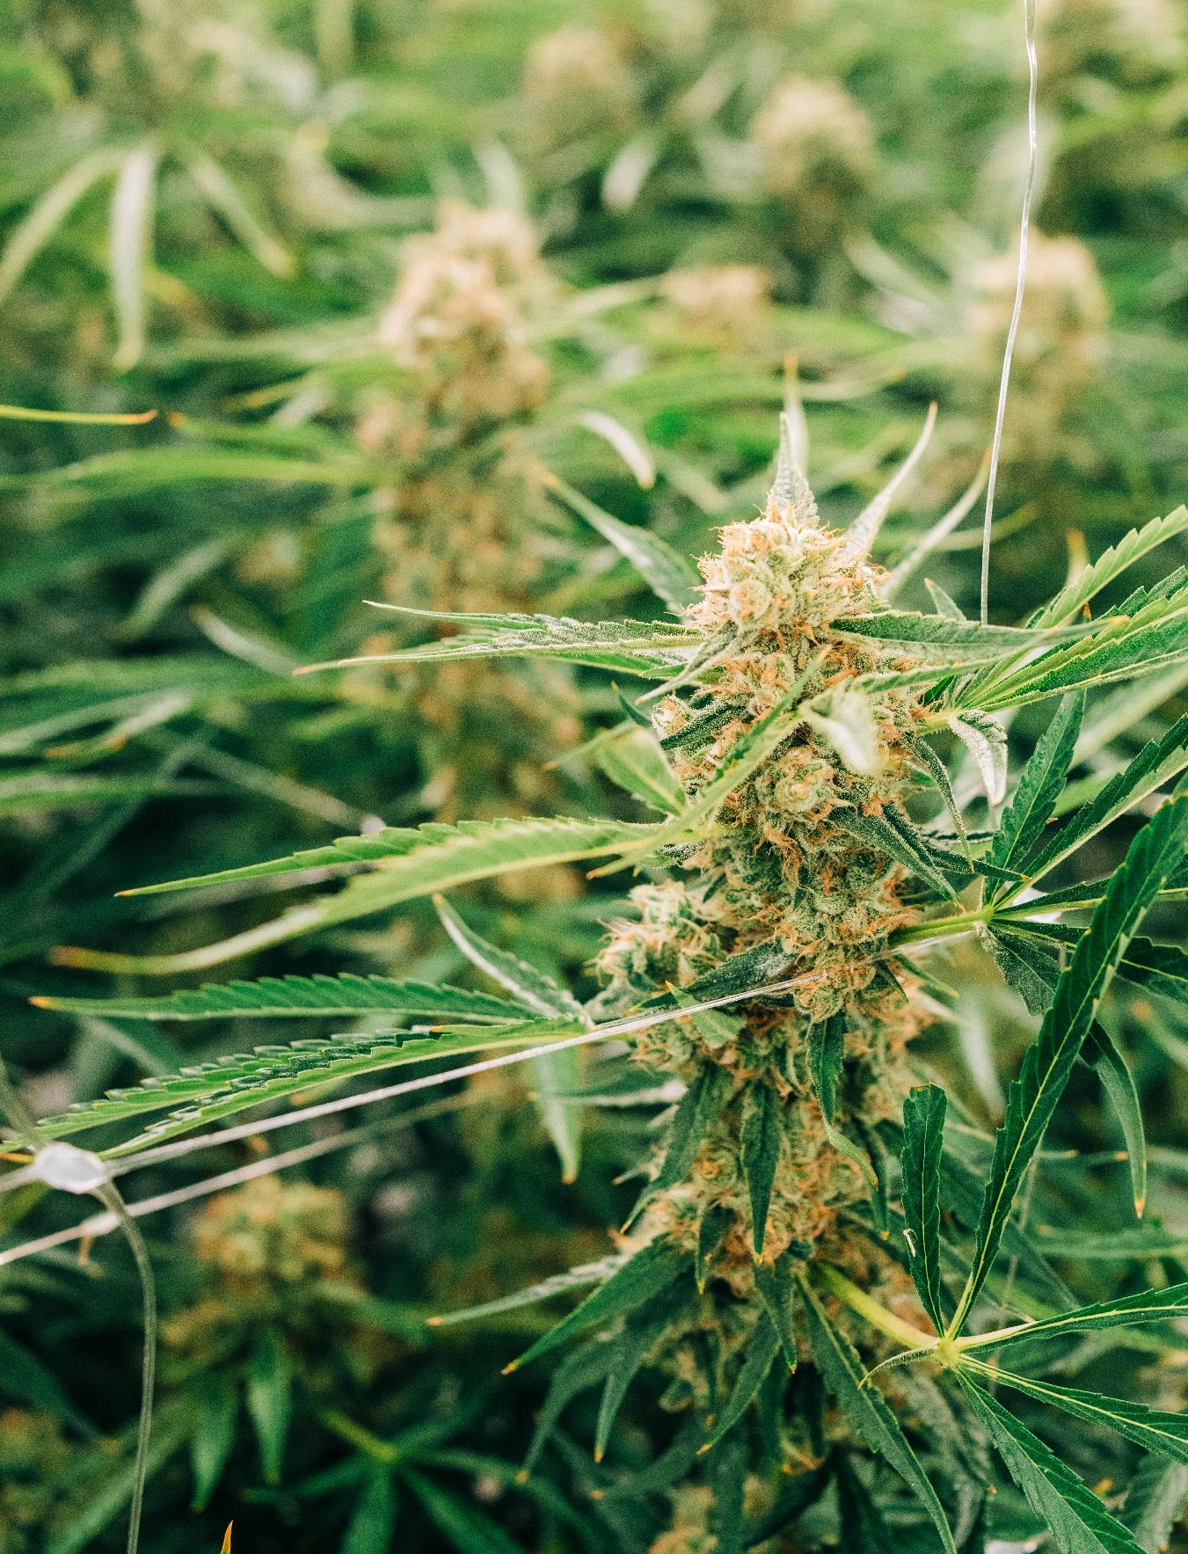
Investor presentation
NASDAQ (OGI)
TSX (OGI)
Q2 Fiscal 2024
03| 31 | 24

Slide 2
Cautionary Statement
This document is current as of March 31, 2024, except where otherwise stated. The information contained in this presentation is provided by Organigram Holdings Inc. (“Organigram” or the “Company”) for informational purposes only and does not constitute an offer to issue or arrange to issue, or the solicitation of an offer to issue, securities of Organigram or other financial products. No part of this presentation shall form the basis or be relied upon in connection with any contract, commitment or investment decisions in relation thereto. The information contained herein is not investment or financial product advice and is not intended to be used as the basis for making an investment decision. No securities commission or similar regulatory authority in Canada or the United States has reviewed this presentation.
No representation or warranty, express or implied, is made as to the fairness, accuracy, completeness or correctness of the information, opinions and conclusions contained in this presentation. This presentation is not meant to provide a complete or comprehensive analysis of Organigram’s financial or business prospects. To the maximum extent permitted by law, none of Organigram nor its directors, officers, employees or agents, nor any other person accepts any liability, including, without limitation, any liability arising out of fault or negligence, for any loss arising from the use of the information contained in this presentation.
This presentation contains forward-looking information. Often, but not always, forward-looking information can be identified by the use of words such as “plans”, “expects”, “estimates”, “intends”, “anticipates”, “believes” or variations of such words and phrases or state that certain actions, events, or results “may”, “could”, “would”, “might” or “will” be taken, occur or be achieved. Forward-looking information involves known and unknown risks, uncertainties and other factors that may cause actual results, events, performance or achievements of Organigram to differ materially from current expectations or future results, performance or achievements expressed or implied by the forward-looking information contained in this presentation. Risks, uncertainties and other factors involved with forward-looking information could cause actual events, results, performance, prospects and opportunities to differ materially from those expressed or implied by such forward-looking information include factors and risks as disclosed in the Company’s most recent annual information form, management’s discussion and analysis and other Company documents filed from time to time on SEDAR+ (see www.sedarplus.com) and filed or furnished to the Securities and Exchange Commission on EDGAR (see www.sec.gov). Readers are cautioned not to place undue reliance on these forward-looking statements, which speak only as of the date of this presentation.
Although the Company believes that the assumptions and factors used in preparing the forward-looking information in this presentation are reasonable, undue reliance should not be placed on such information and no assurance can be given that such events will occur in the disclosed time frames or at all. The forward-looking information included in this presentation is made as of the date of this presentation and the Company disclaims any intention or obligation, except to the extent required by law, to update or revise any forward-looking information, whether as a result of new information, future events or otherwise. The descriptions of the terms of the agreements referenced in this release are qualified by the terms of the agreements themselves, copies of which shall be filed under Organigram’s profile on SEDAR+ (see www.sedarplus.com) and filed or furnished to the Securities and Exchange Commission on EDGAR (see www.sec.gov).
The financial information in this document contains certain financial performance measures that are not defined by and do not have any standardized meaning under IFRS and are used by management to assess the financial and operational performance of the Company. These include adjusted EBITDA and adjusted gross margin (adjusted gross margin %). The Company believes that these non-IFRS financial measures, in addition to conventional measures prepared in accordance with IFRS, enable investors to evaluate the Company’s operating results, underlying performance and prospects in a similar manner to the Company’s management. As there are no standardized methods of calculating these non-IFRS measures, the Company’s approach may differ from those used by other issuers, and accordingly, the use of these measures may not be directly comparable. Accordingly, these non-IFRS measures are intended to provide additional information and should not be considered in isolation or as a substitute for measures of performance prepared in accordance with IFRS. For further information regarding these non-IFRS measures, including definitions, and a quantitative reconciliation to the most directly comparable IFRS measure, see the information under the heading "Cautionary Statement Regarding Certain Non-IFRS Measures" and the reconciliation to IFRS measures under the heading "Financial Results and Review of Operations" in the Company's management discussion and analysis of financial conditions and results of operations for the three months ended March 31, 2024 and February 28, 2023 (the "Q2 Fiscal 2024 MD&A") incorporated by reference in this presentation and filed under Organigram's profile of SEDAR+ (see www.sedarplus.com) and filed or furnished to the Securities and Exchange Commission on EDGAR (see www.sec.gov).
This presentation does not constitute an offer of shares for sale in the United States or to any person that is, or is acting for the account or benefit of, any U.S. person as defined in Regulation S under the United States Securities Act of 1933, as amended (the “Securities Act”) (“U.S. Person”), or in any other jurisdiction in which such an offer would be illegal. Organigram’s shares have not been and will not be registered under the Securities Act. We seek safe harbour. This document may not be reproduced, further distributed or published in whole or in part by any other person. This document may only be disseminated or transmitted into any jurisdiction in compliance with, and subject to, applicable securities laws. Readers are required to ensure their compliance with applicable securities laws.
This investor presentation contains information concerning our industry and the markets in which we operate, including our market position and market share, which is based on information from independent third-party sources. Although we believe these sources to be generally reliable, market and industry data is inherently imprecise, subject to interpretation and cannot be verified with complete certainty due to limits on the availability and reliability of raw data, the voluntary nature of the data gathering process, and other limitations and uncertainties inherent in any statistical survey or data collection process. We have not independently verified any third-party information contained herein.

Slide 3
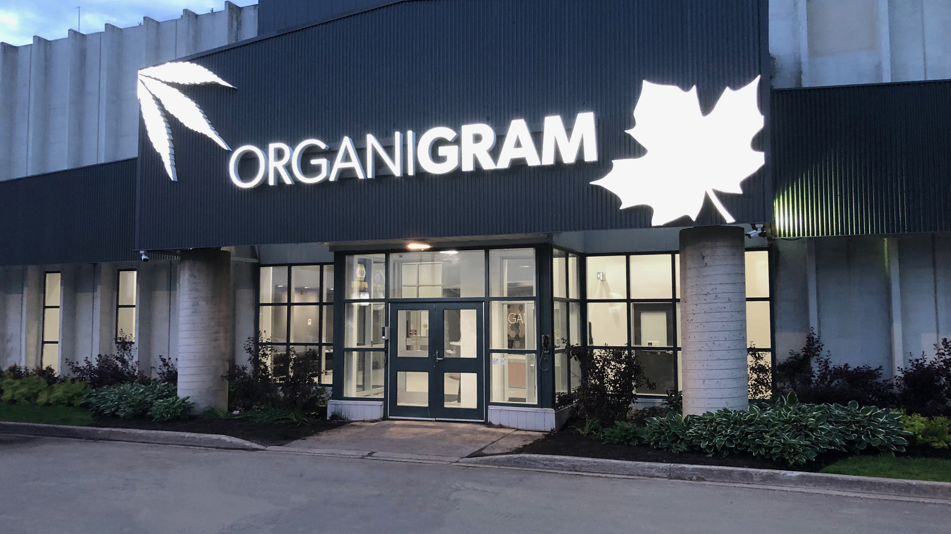

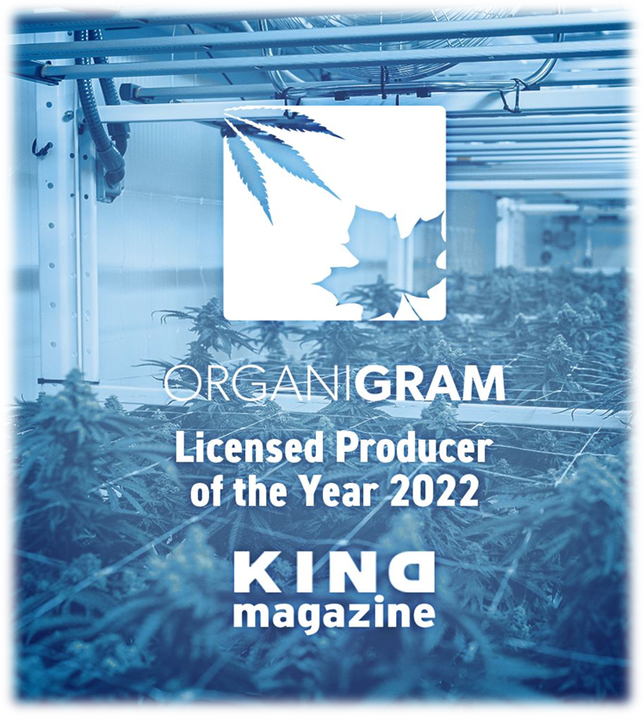


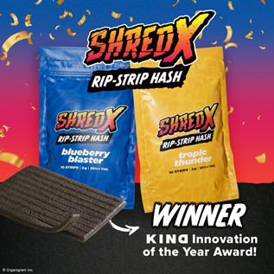

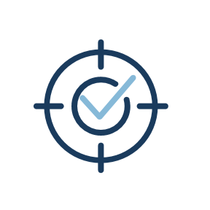
Moncton’s flagship facility
AN AWARD-WINNING CANNABIS LICENSED PRODUCER WITH A PRESENCE ACROSS CANADA AND A GROWING INTERNATIONAL FOOTPRINT
Our Vision:
To be a respected global leader in the emerging cannabis movement.
Our Mission:
To delight consumers with trusted brands that deliver innovative cannabis products and experiences while promoting education and industry advocacy.

Slide 4

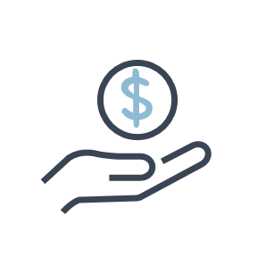





Organigram KEY STRENGTHS
One of the strongest balance sheets among LPs
Negligible debt & ~$195 million in pro-forma cash¹
Three state-of-the-art specialized facilities & the largest indoor grow in Canada
Distribution spans all Canadian provinces with seven international export partners in Germany, UK, Israel, & Australia
US exposure through 2 strategic investments
Innovation focus with several first-to-market launches including milled flower, Rip-Strip hash, whole-flower THCV, & ingestible extracts
Consistently a top 3 LP in national market share
#1 & #2 in multiple product categories²
Pro-forma cash as of the anticipated closing of all tranches of the $124.6M British American Tobacco p.l.c. ("BAT") investment
2. As of March 31, 2024 – Multiple sources (Hifyre, Weedcrawler, Provincial Board Data, Internal Modelling)

Slide 5


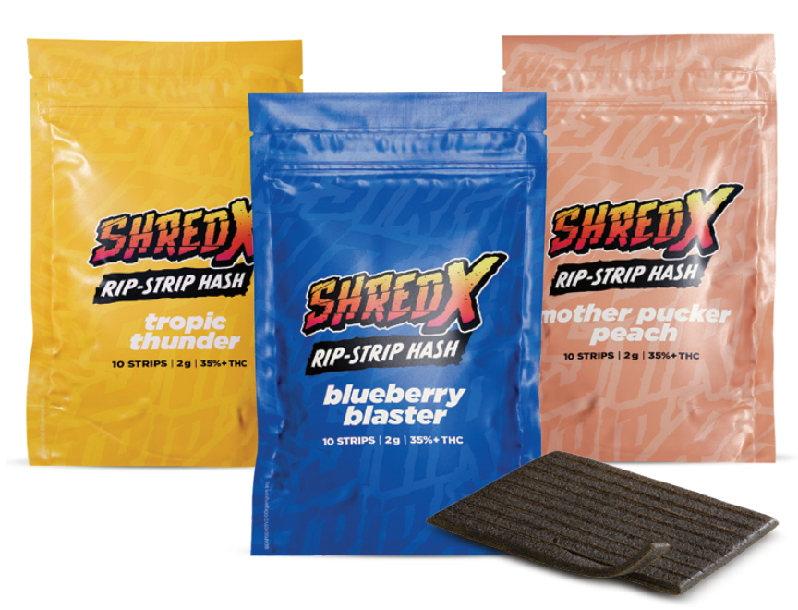
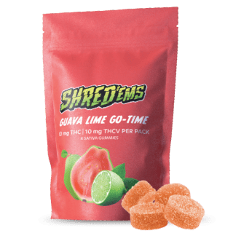
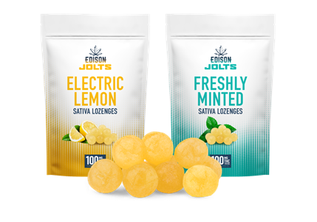
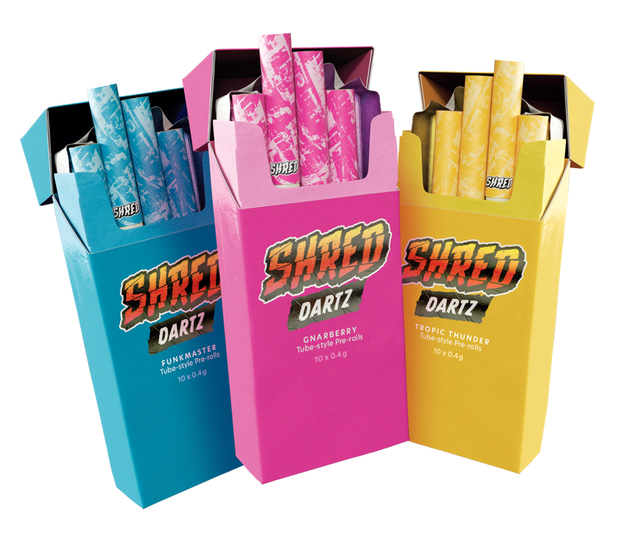
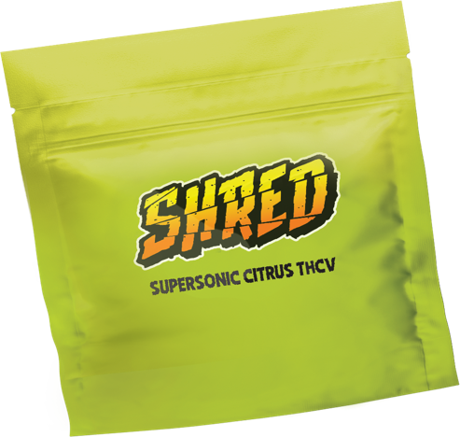
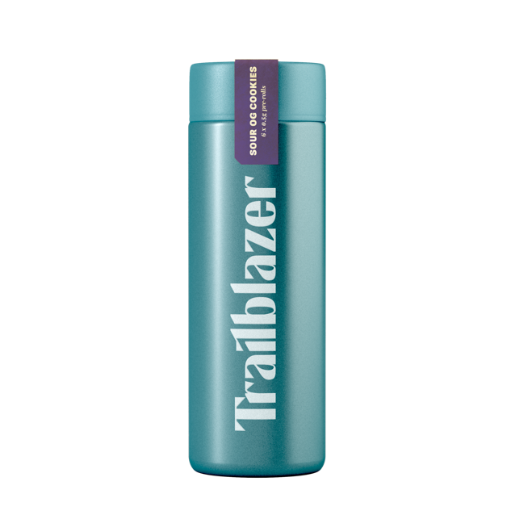
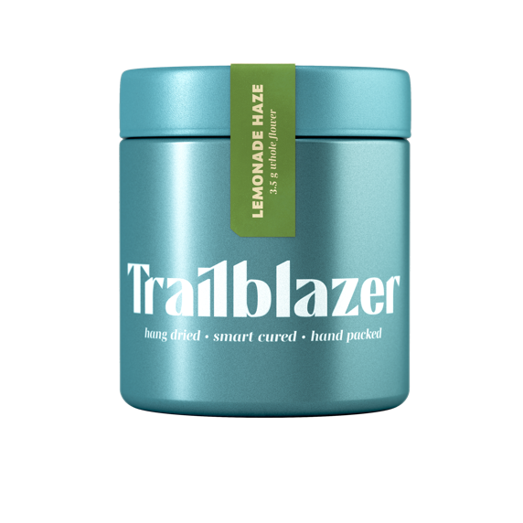
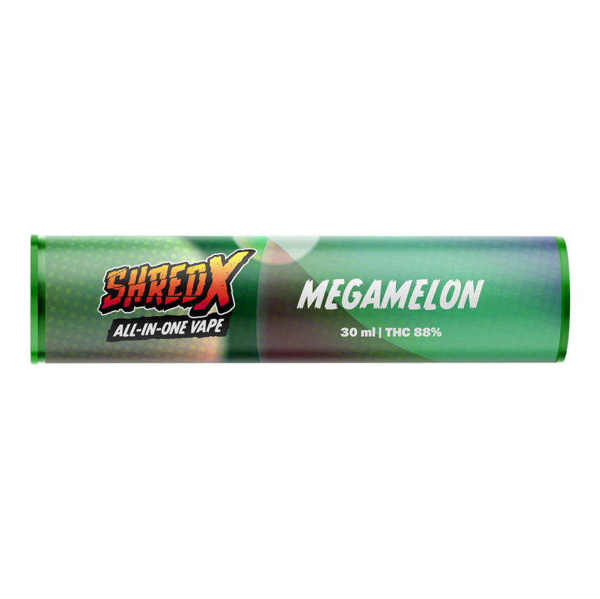
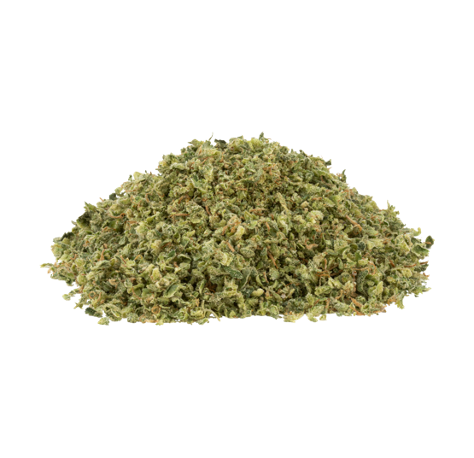
Near-term strategy
  Revolutionized hash with patent-pending SHRED X Rip-Strips
  SHRED brand has achieved $200 million in annual retail sales¹
  First to market with ingestible extracts and flavor forward milled flower
  Introduced whole-flower derived THCV products to the Canadian consumer
  Developing revolutionary vape hardware and liquids to address growth in the category
  Launched the Company’s first carton of joints in market - 7 packs of 10 tube-style PRs
  Planning launch of nano-emulsion ingestibles with clinically studied benefits to substantiate claims of rapid onset and predictable duration in fall 2024
Organigram is focused on innovation informed by consumer research, resulting in market share leadership in several categories
INNOVATION
CONSUMER
FOCUS
1. As of March 31, 2024 Multiple Sources (Hifyre, Weedcrawler, provincial boards, internal modelling).

Slide 6


long-term strategy
Organigram has strategically deployed significant capital to increase production efficiency, advance innovation, elevate product quality, and has increased its cash position to fuel international expansion
  Production and packaging lines for gummies, milled flower, and pre-rolls are now highly automated
  Conversion of portion of grow rooms to seed-based production in Fiscal 2024 drives product consistency and further cost savings
  Capital raised in Fiscal 2024:
    $124.6 million follow-on investment from BAT to fund international and strategic growth initiatives¹
    $28 million oversubscribed underwritten offering announced in March 2024 and close in April 2024 to fund growth initiatives and for general corporate purposes
  Current export partners in Australia, Germany, Israel, & UK ($18.9 million in international shipments in Fiscal 2023 to Israel and Australia)
  EU-GMP preliminary audit of Moncton facility successful and awaiting official audit
EFFICIENCY
EXPANSION
1. Announced on November 6, 2023 and subject to completion of two additional tranches.

Slide 7
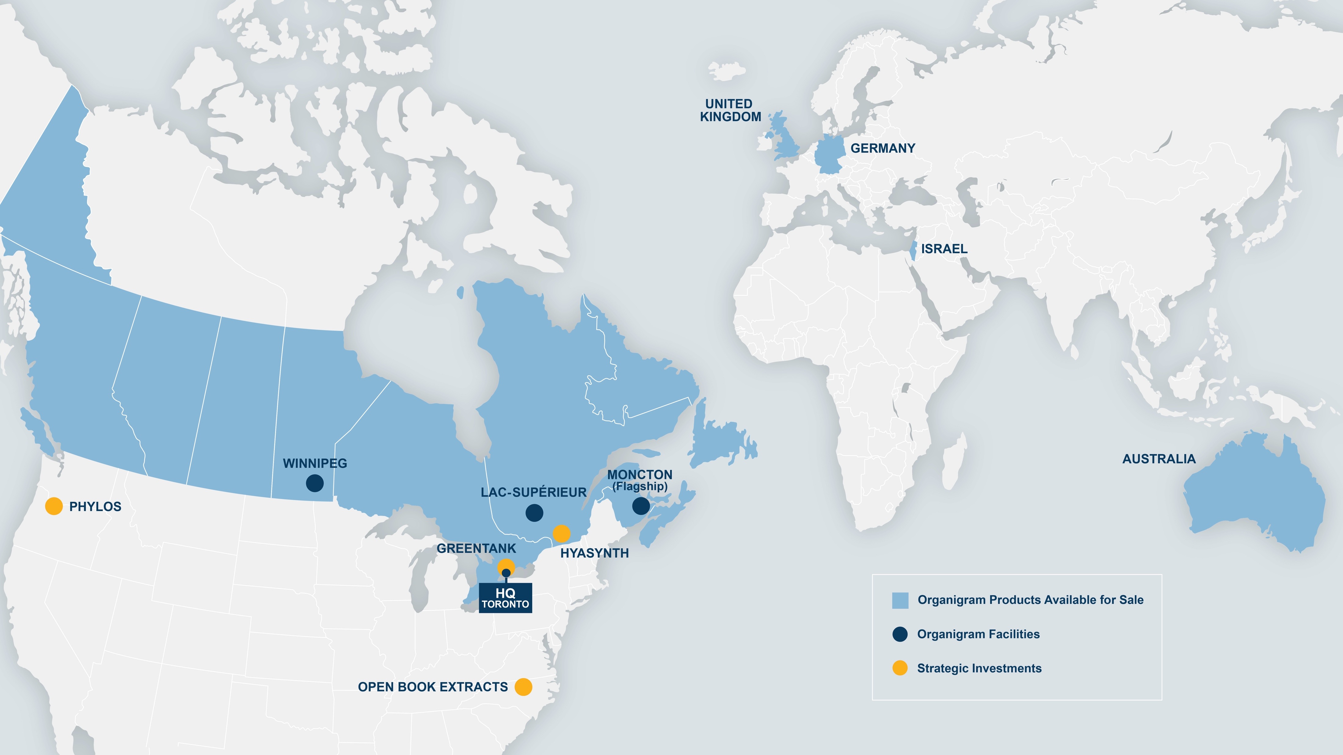
Organigram’s global footprint

Slide 8
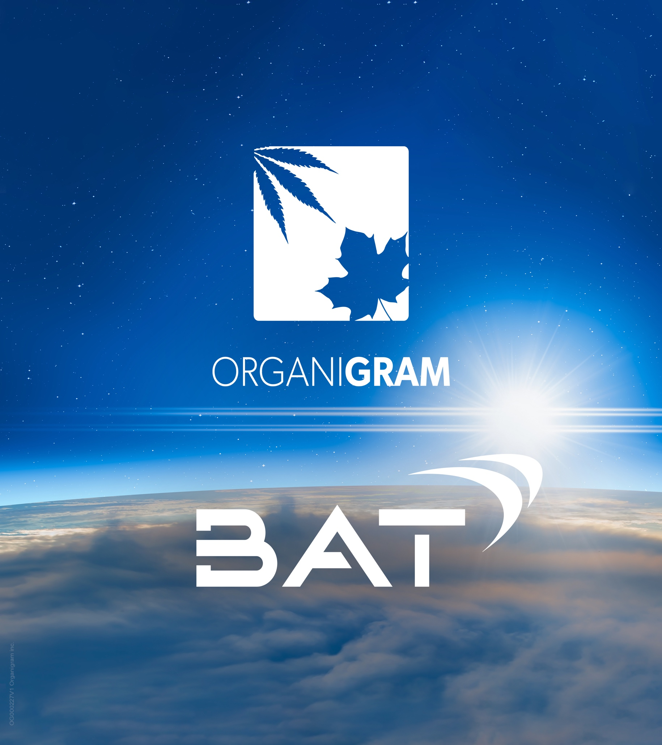
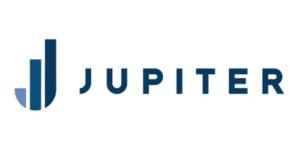
BAT investments in Organigram
Product Development Collaboration
March 2021 - $221 million strategic investment from subsidiary of BAT for 19.9% equity interest¹ in Organigram​
Product Development Collaboration (PDC) with formation of a Center of Excellence (CoE) at our Moncton campus ​
Focused on developing the next generation of cannabis products, IP and technologies​
November 2023 - $124.6 million follow-on investment from subsidiary of BAT in three equal tranches between January 2024 and February 2025 for: ​
45.0% economic interest in private placement at C$3.22 per share²
Organigram to create a Strategic Investment Pool named Jupiter, to be funded with C$83.1 million over the course of the three tranches of the investment​
Jupiter will target investments in emerging cannabis opportunities that enable Organigram to apply industry-leading capabilities to new markets
$41.5 million proceeds for general corporate purposes
First $41.5 million tranche closed in January 2024
Project Jupiter
Calculated on a non-diluted basis.
2. On the last trading day pre-announcement (November 3, 2023) of the transaction. Organigram shares closed at C$1.59/share on the Toronto Stock Exchange.

Slide 9
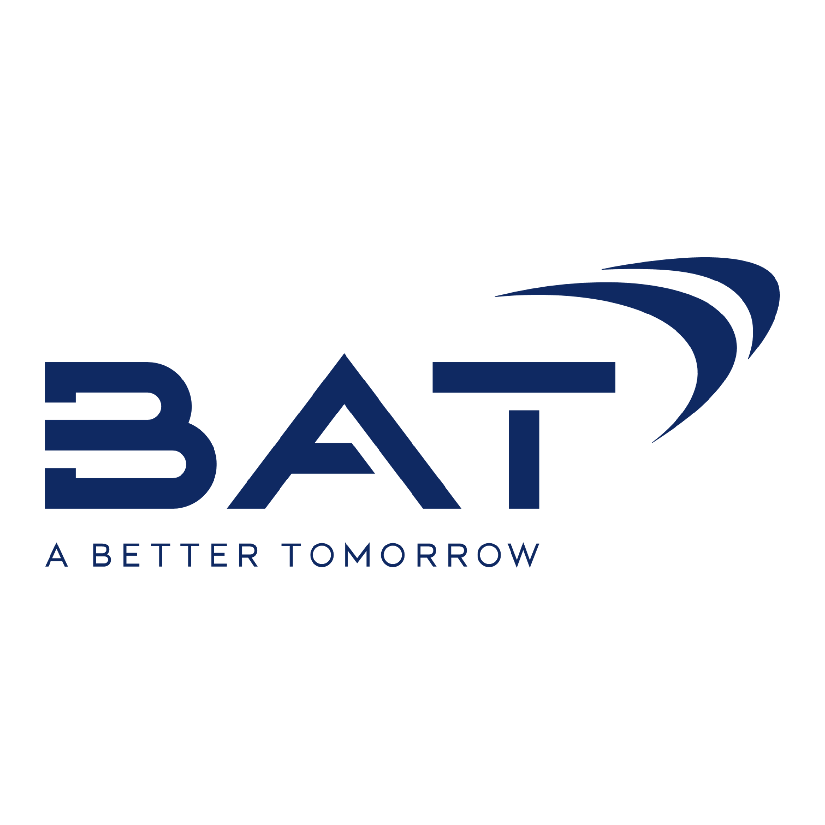

PRODUCT DEVELOPMENT COLLABORATION
Organigram and BAT contribute complimentary capabilities and share a commitment to responsible category stewardship. The PDC continues to focus on the development of next generation products, adhering to the highest regulatory and compliance standards
Collaboration Highlights
Since March 2021, following a $221 million strategic investment from BAT subsidiary, the partnership has gone from strength-to-strength
Significant achievements have materialized from a scientific development standpoint in terms of revenue driving product capability
Organigram has benefitted from BAT’s deep understanding of plant science and device and product technology
BAT has gained substantial knowledge from Organigram with respect to the cannabis plant and product category
The PDC is in late-stage development of a suite of emulsions, novel vapour formulations, flavour innovations, and packaging solutions which are to be applied across some products in Organigram’s portfolio in calendar year 2024
For ingestible innovations, Organigram has completed pharmacokinetic (PK) studies to substantiate benefits of emulsification technologies and preliminary results are promising
“PDC”
Dedication to Research and Product Development

Slide 10
project jupiter
The $83 million Jupiter investment pool will target investments in emerging cannabis opportunities
1​
Priority Investment
Pillars
Geographies
USA
Emerging global markets
2​
All potential investments will be made against Organigram’s strategic vision for the future, focusing on long-term sustainable growth and global cannabis leadership
Targeting investments that will enable Organigram to apply its industry-leading capabilities to new markets
Jupiter to be set-up and managed by an internal team at Organigram
Internal team will be focused on sourcing future investments, enabling both an entrepreneurial approach and application of best-in-class knowledge
All investments will go through legal due diligence, ensuring compliance with both applicable laws and Organigram's listings on the NASDAQ & TSX
Categories & Tech
Non-combustible inhalation
Edibles
Beverages
Novel IP & devices
3​
Sectors
Adult-use THC
Hemp-derived CBD/CBD+ (minor cannabinoids)
CPG
Cannabis ancillary
4​
Value Chain Segments
Genetics
Product development
Brand

Slide 11

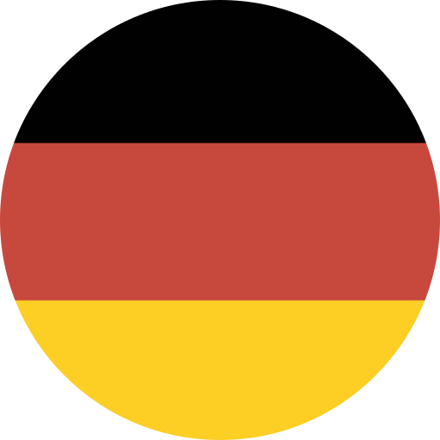



Domestic & International expansion
Organigram continues to grow domestic market share in key categories and over-indexes in international sales as a proportion of Canadian exports:
Canadian Market
Rest of World
#3 market share position in Canada¹
#2 market share in gummies¹
#1 market share in milled flower and hash¹
#1 market share in Atlantic Canada, and #3 in Ontario and a top 5 LP in every other province¹
Expanding market share in the rapidly growing pre-roll category after recent highly successful launches of tube-style pre-rolls and diamond + distillate infused-pre-rolls, resulting in claiming the #3 position in the overall pre-roll category¹
In Fiscal 2023 Organigram shipped an estimated 10% of all exported product from Canada² to international markets (including Israel and Australia)
New supply agreements signed with Sanity Group GmbH ("Sanity Group") in Germany and 4C Labs Ltd. ("4C Labs") in the UK expected to bolster international sales in Fiscal 2024 – First flower shipped to Germany in Q1 Fiscal 2024. First sales destined for UK in Q2 Fiscal 2024
In Fiscal 2023 Organigram shipped $18.9 million in flower vs. $15.1 million in Fiscal 2022
As of March 31, 2024 – multiple sources (Hifyre, Weedcrawler, provincial boards, internal modelling).
Measured by dollar value and sourced from BDSA, available Statistics Canada data & internal shipped sales data.

Slide 12

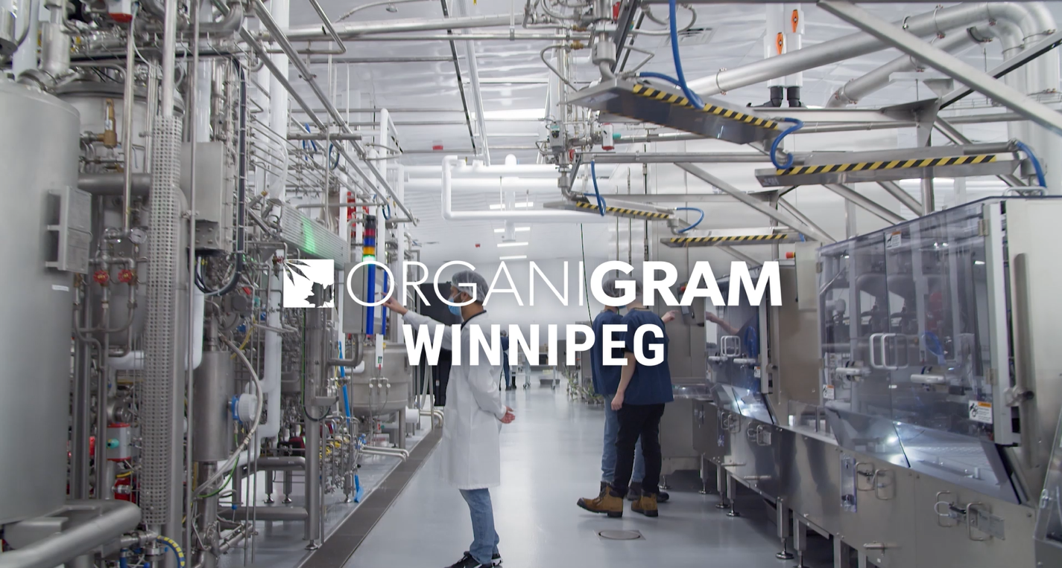
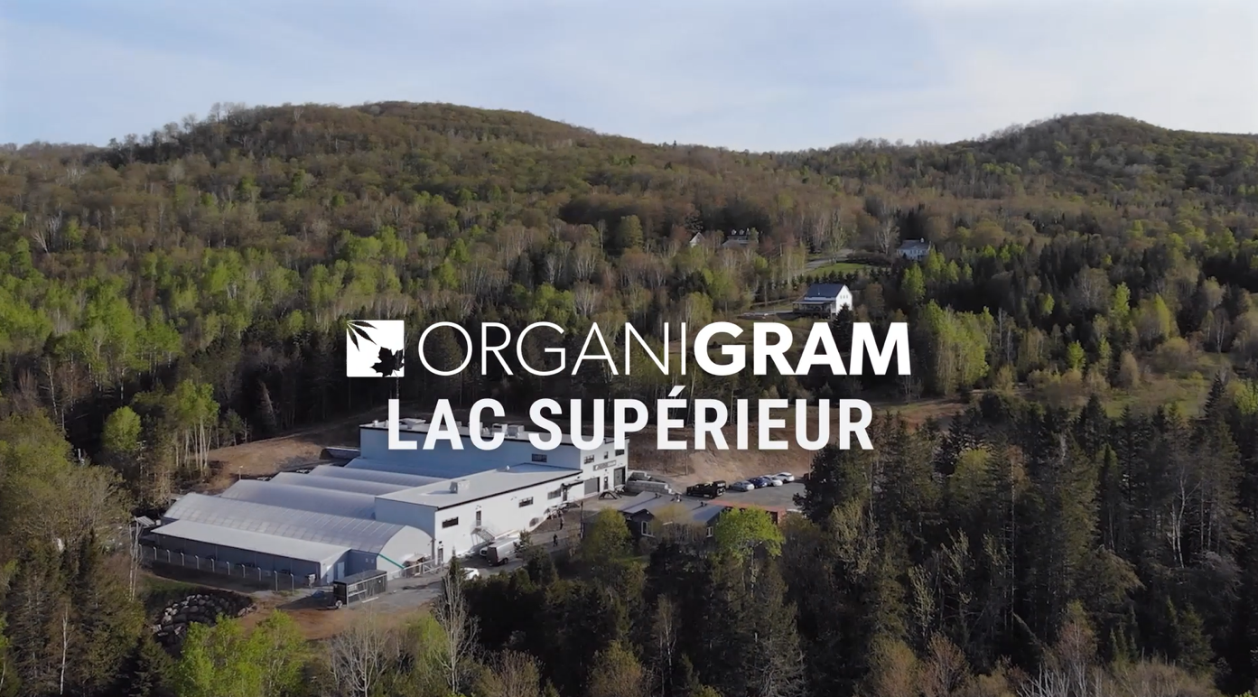
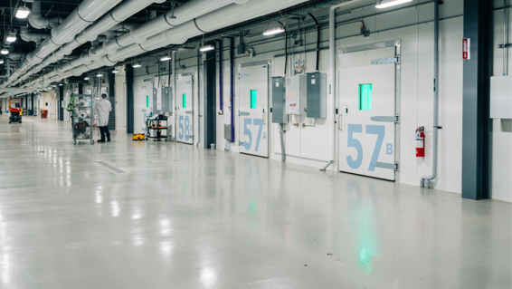
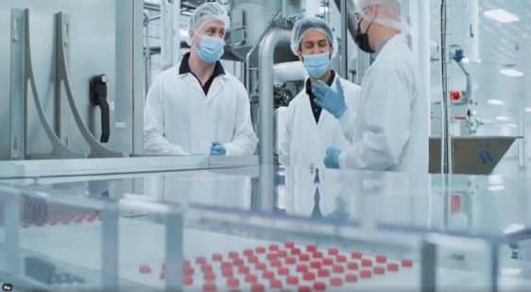
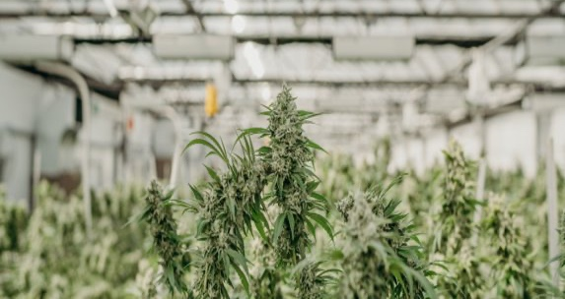
State of the Art facilities
Organigram's legacy of execution excellence & stability is established in the Canadian market, supported by three fully-scaled, state-of-the-art facilities:
Moncton (Flagship)
Winnipeg
Lac-Supérieur
One of the largest indoor cannabis facilities in the world
~85,000 kg/year of low-cost, high-quality indoor flower
Over 130, three-tiered, modular, strain-specific grow rooms provide the ability to control critical environmental requirements per strain
11 additional plant science rooms for testing prior to commercial launch
In-house cannabinoid testing and remediation
51,000 sq. ft. edibles facility with automated cutting-edge equipment capable of producing up to 4 million gummies monthly
Designed to produce nutraceutical-grade cannabis edibles including pectin, gelatin, and sugar-free soft chews, toffee, and caramel with novel capabilities
Ramping up to produce nano-emulsion ingestible products with potential rapid onset and predictable duration
Producing hang-dried, hand-trimmed, artisanal craft cannabis and premium Afghan-style hash
Hash production capacity of 2 million units per year
Greenhouse expansion from 600kg/yr to 2,400kg/yr of craft flower recently completed with first harvest completed in December 2023

Slide 13
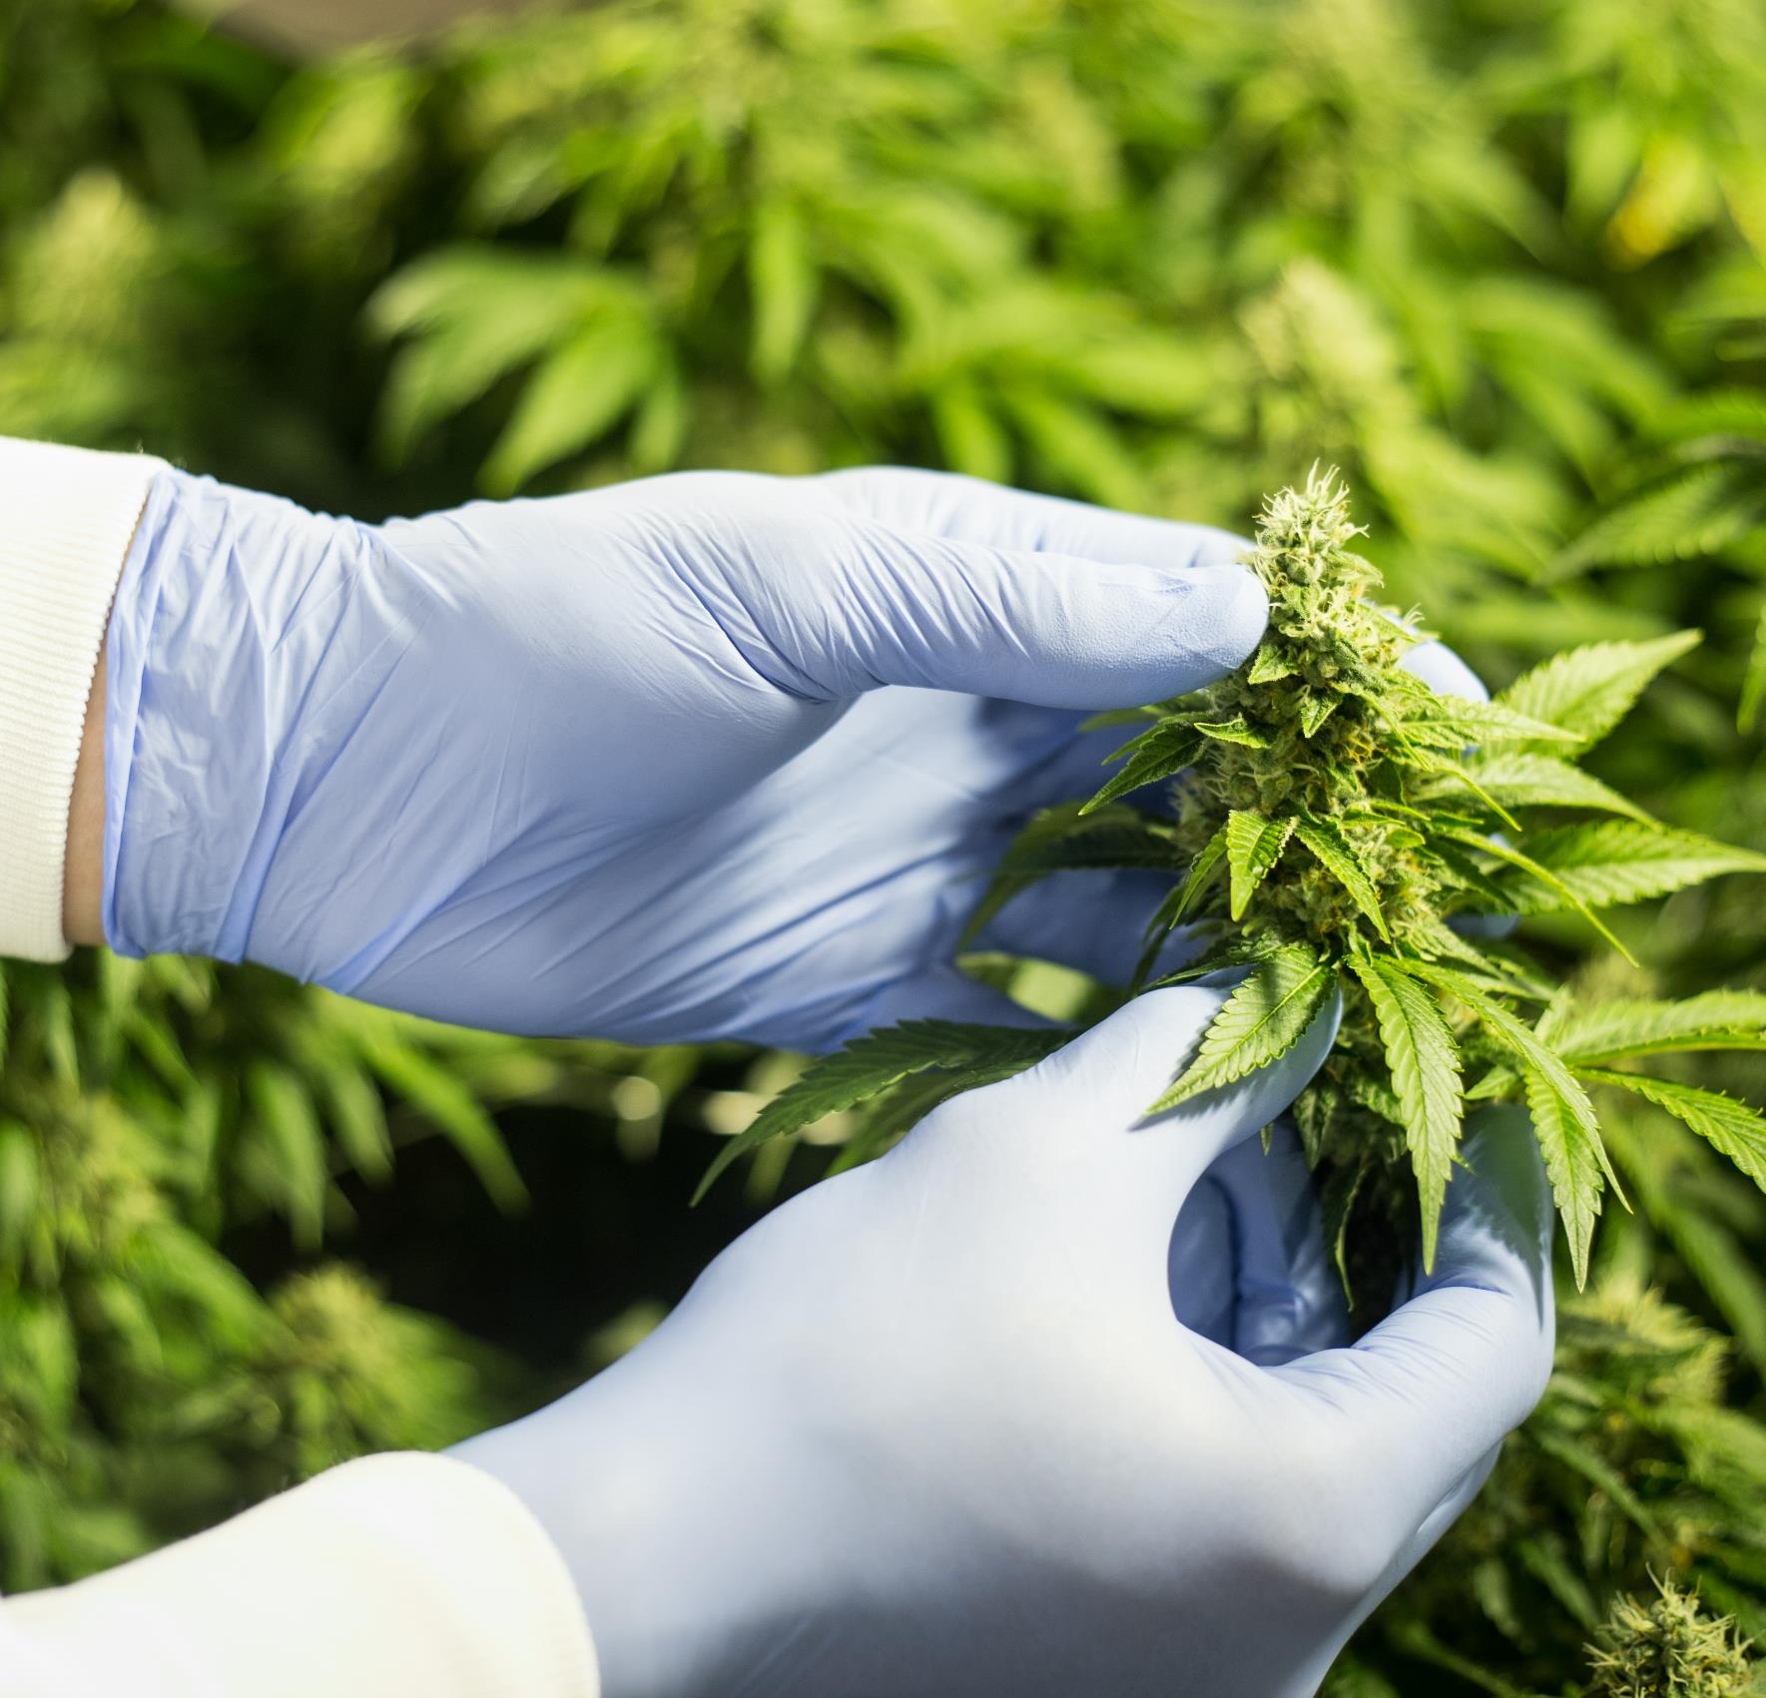
Brand portfolio

Slide 14


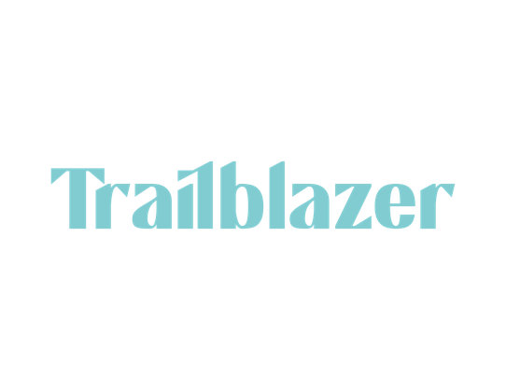

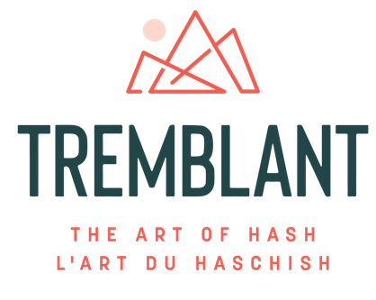

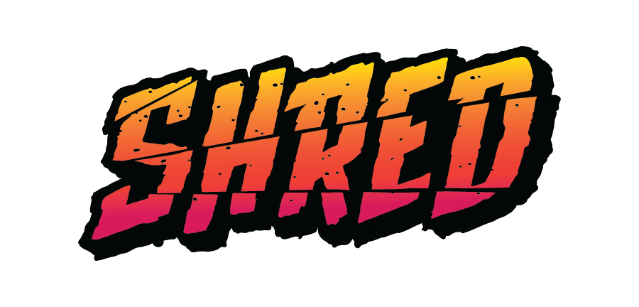

WELL-ROUNDED BRAND PORTFOLIO
Recently hit $200 million in annual retail sales
Pricing Segment | Super Value | Value | Value | Mainstream | Mainstream | Mainstream | Premium | Craft
Available / Planned Formats | Whole Flower | Whole Flower Pressed Hash | Pre-Milled Flower, Pre-Roll Joints, Infused Gummies, 510 Vape Carts, Rip-Strip Hash & Infused Pre-Rolls | CBD & Minor Cannabinoid Gummies | Pre-Rolls, Whole Flower, Infused Pre-Rolls, THC & Minor Cannabinoid Gummies | Whole Flower, Pre-Roll Joints & Lozenges | Hashish, Hash Infused Pre-rolls & Pre-rolls | Whole Flower Pre-Roll Joints
Tangible Brand Attributes | Strain Specific Flower High Quality Genetics Good value | Iconic Strains High Potency Products Killer Prices | Good THC Potency Great Value Big Flavour | Assorted Flavours Vegan & Sugar-free Offerings | Assorted Flavours Vegan & Sugar-free Offerings | Potent & Flavourful Strains Unparalleled Genetics Strain Specific Grow Rooms | Authentic Recipes High Potency Hash | Hand Trimmed Hand Packed Hang Dried

Slide 15
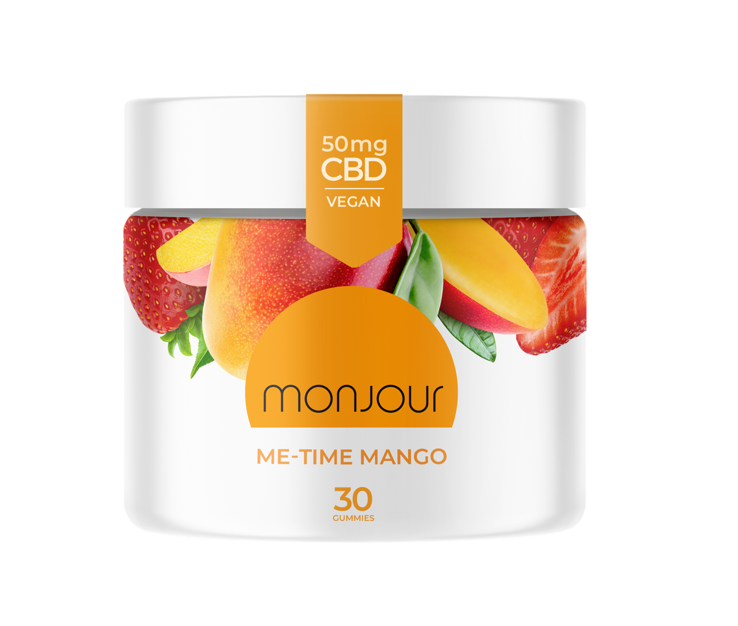
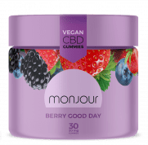
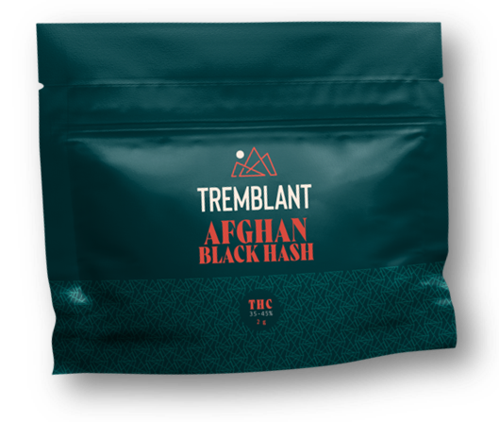
DYNAMIC BRAND PERFORMANCE
Rip-Strip Hash on a Tear
Launched in March 2023
Over 400K units shipped approaching $12 million in retail sales as of April 30, 2024¹
Monjour Market Share Up by 7.4% vs. Prior Year Q2¹
Monjour held >50% of the pure-CBD national market share as of Q2 Fiscal 2024²
Organigram is the #1 LP in Concentrates¹
Organigram holds >20% of national market share in hash as of Q2 Fiscal 2024² and is the largest hash producer globally
1.As of April 30, 2024 – Multiple Sources (Hifyre, Weedcrawler, provincial boards, internal modelling).
2. As of March 31, 2024 Multiple Sources (Hifyre, Weedcrawler, provincial boards, internal modelling).

Slide 16
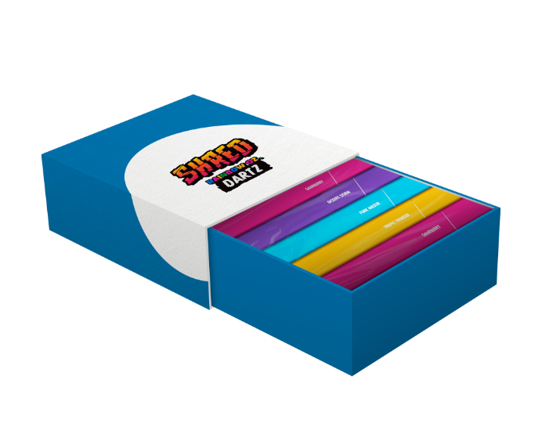
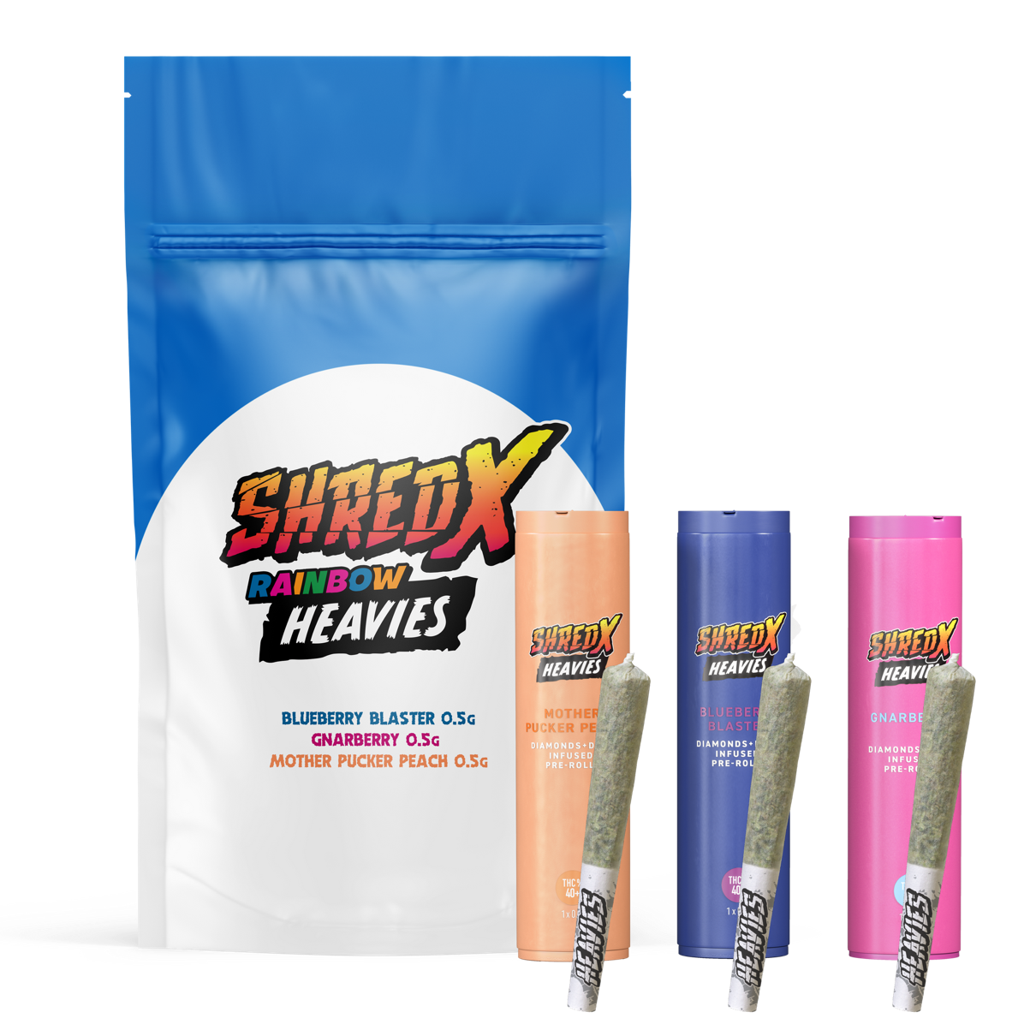

DYNAMIC BRAND PERFORMANCE
SHRED X Heavies – 40%+ THC Infused Pre-Rolls (IPRs)
IPR’s are the biggest contributor for growth in Canada (46% of overall growth came from IPRs vs LY)¹
In Q2 Fiscal 2024 Organigram was #2 in infused pre-rolls¹
Tube Style Pre-Rolls
Tube style pre roll segment growing at 2X rate of Market & nearly 4x Cone Pre-Rolls
In Q2 Fiscal 2024 Organigram gained #3 spot in pre-rolls¹
1.As of March 31, 2024 – Multiple Sources (Hifyre, Weedcrawler, provincial boards, internal modelling).
Notes:
Rainbow Heavies

Slide 17
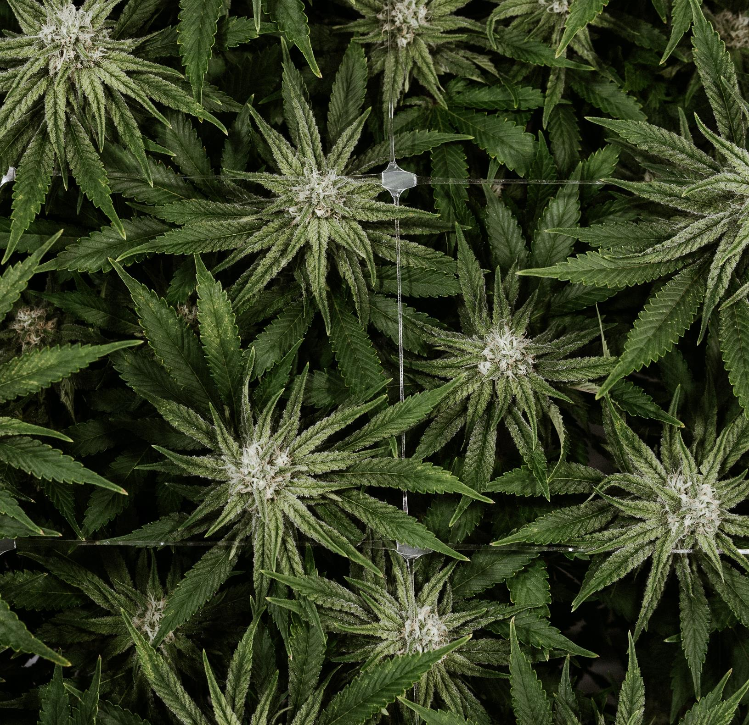
Strategic investments

Slide 18
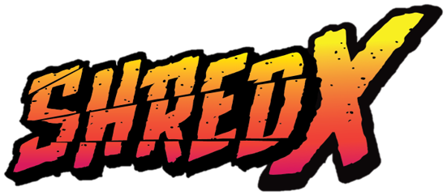


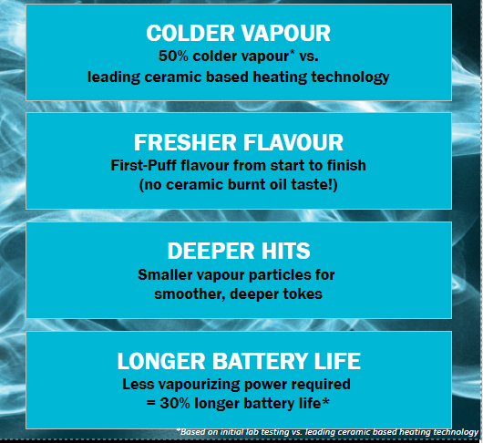
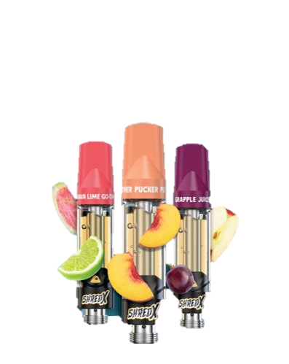
INVESTMENT IN DISRUPTIVE
Vaping Technology
In March of 2023, Organigram invested $5.5 million into Green Tank Technologies Corp. ("Greentank"), a vape R&D firm and hardware manufacturer
Greentank's heating technology is the first meaningful innovation in the vape space in almost a decade
Invented a novel heating element which replaces ceramic which will produce more consistent flavour, reduce clogging and produce smaller particle size which may increase potency
With an 18-month exclusivity period, the Company believes it will transform its vape hardware line-up and enhance market position
Test launch completed in Q2 Fiscal 2024. Full market launch expected in near term.

Slide 19
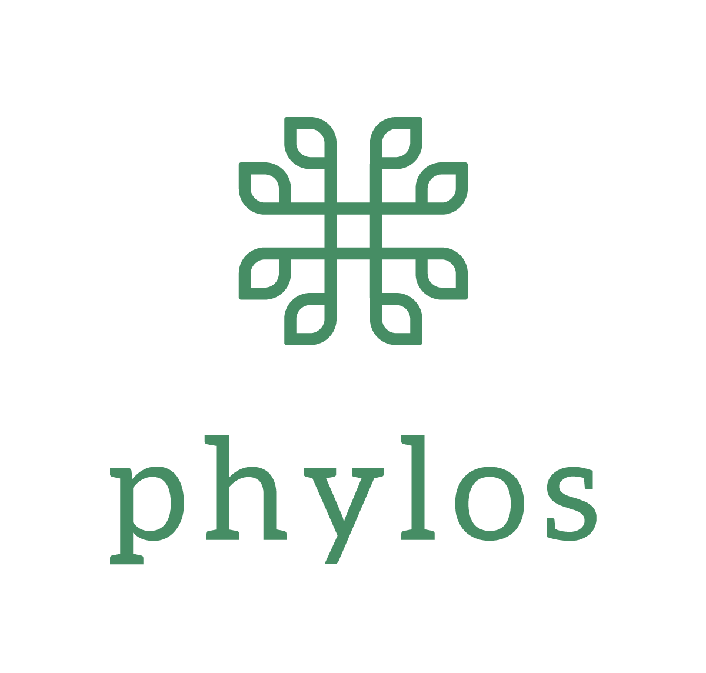
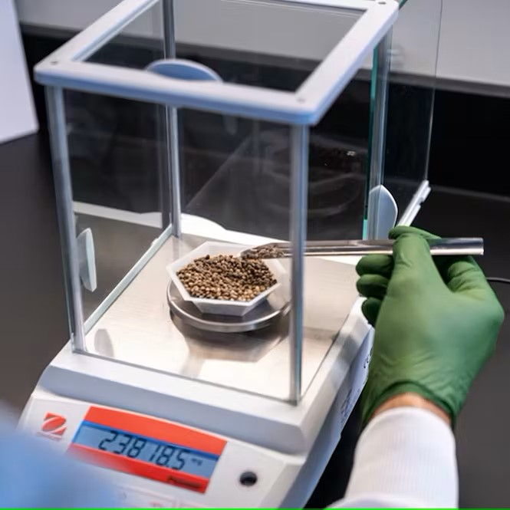
INVESTMENT IN Seed genetics & thcv
In May of 2023, Organigram made its first investment into the U.S cannabis market by issuing a strategic convertible loan to Phylos Bioscience Inc. ("Phylos")
Phylos will enable Organigram to accelerate the launch of products containing THCV in the Canadian market – THCV provides consumer with a differentiated experience compared to THC (appetite suppression, no cognitive impairment, energizing and focusing effect)
Organigram will significantly reduce operating costs by transitioning its flower production from cloning to seed which reduces the need for cloning, propagation, and pre-vegetation
Seed-based cultivation using "F1" seeds produces more robust and consistent plants, yielding consistent cannabinoid and terpene profiles, uniform size, and other desirous qualities.
In Q1 Fiscal 2024, due to the achievement of THCV concentration and aroma specific milestones from F1 seeds, Organigram advanced the second tranche of US$2.75 million to Phylos for a total current investment of US$6.0 million in senior secured convertible loans
First seed-based room harvested in Q2 Fiscal 2024 with three additional rooms planted, moving toward goal of 30% seed-based production by end of calendar 2024

Slide 20

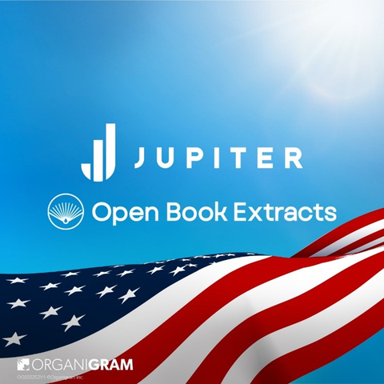
INVESTMENT US Hemp-derived cannabinoids
In March 2024, Organigram made its first Jupiter investment into US-based Steady State LLC (d/b/a Open Book Extracts) ("OBX") as a convertible note for US$2 million
The investment in OBX provides a further footprint in the U.S, which was a strategic priority set out in the Jupiter investment strategy
OBX is a professional, quality-led company that is growing quickly and is uniquely positioned to leverage the expanding legal hemp derivatives market
Through its investment in OBX, Organigram will gain valuable insights into the U.S. market and its consumers. In time, Organigram plans to work with OBX to explore potential product launches in the U.S.
OBX and Organigram are currently discussing an opportunity for OBX to serve as a collaborative research partner for efficacy testing, technology development, and formulation sciences
OBX is nearing completion of its EU GMP certification, which will create further international collaboration opportunities between OBX and Organigram

Slide 21
INVESTMENT IN DISRUPTIVE
TECHNOLOGY-BIOSYNTHESIS
49% ownership (if convertible debt converted) of Hyasynth Biologicals Inc., a pioneer in cannabinoid science
Biosynthesis process uses patent-pending yeast strains and enzymes to produce pure cannabinoids (not synthetic) without growing cannabis plants
Potential to create a scalable supply of pure cannabinoids at a fraction of the cost and time of traditional cultivation using smaller environmental footprint
BIOSYNTHESIS
How it works?
Biosynthesis can be used to produce cannabinoids that are identical to those produced by the plant itself.
A proprietary cannabinoid manufacturing system that can product rare cannabinoids.
Genome engineering of yeast: A group of genes for cannabinoid production are added to the yeast genome of a yeast strain, where it provides instructions to produce cannabinoid compounds.
1
Yeast fermentation and purification: New yeast strains are grown in fermentation over a few days and pure cannabinoids are extracted at the end of the process.
2
3
The process is conducted at large scale, resulting in pure cannabinoids that can be used as ingredients in other products.

Slide 22

international

Slide 23

Significant INTERNATIONAL sales GROWTH
INTERNATIONAL NET REVENUE¹
$ millions
International shipments do not attract Canadian Federal excise taxes and therefore gross, and net revenues are equal.
F2023 represents 13 months due to a change in Organigram's year end.
2

Slide 24

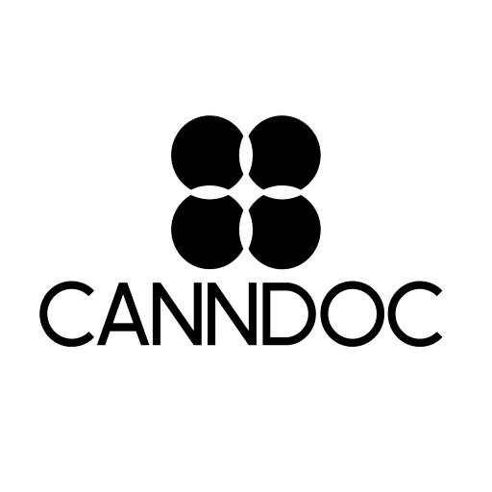
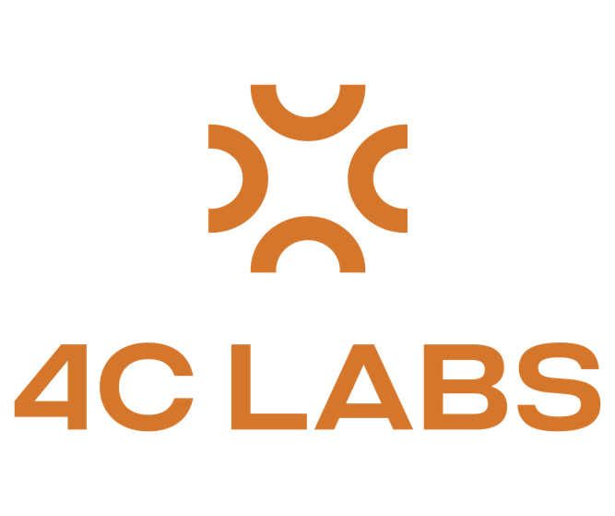

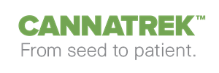
INTERNATIONAL business
In Fiscal 2023 Organigram shipped $18.9 million in flower to Israel and Australia vs. $15.1 million in Fiscal 2022
In Q2 Fiscal 2024, Organigram shipped first flower to Sanity Group in Germany and 4C Labs for first UK distribution
Expecting first shipments to new supply partners in Australia and the UK in Q3 Fiscal 2024
Organigram currently has 7 distribution partners in four countries (Israel, Australia, UK, and Germany)
Activities are subject to compliance with all applicable laws, including receipt of all requisite approvals from Health Canada, the Israeli Ministry of Health, and any other applicable regulatory authorities and changing regulatory landscape.

Slide 25

Quarterly updates & Highlights
Q2 F2024

Slide 26
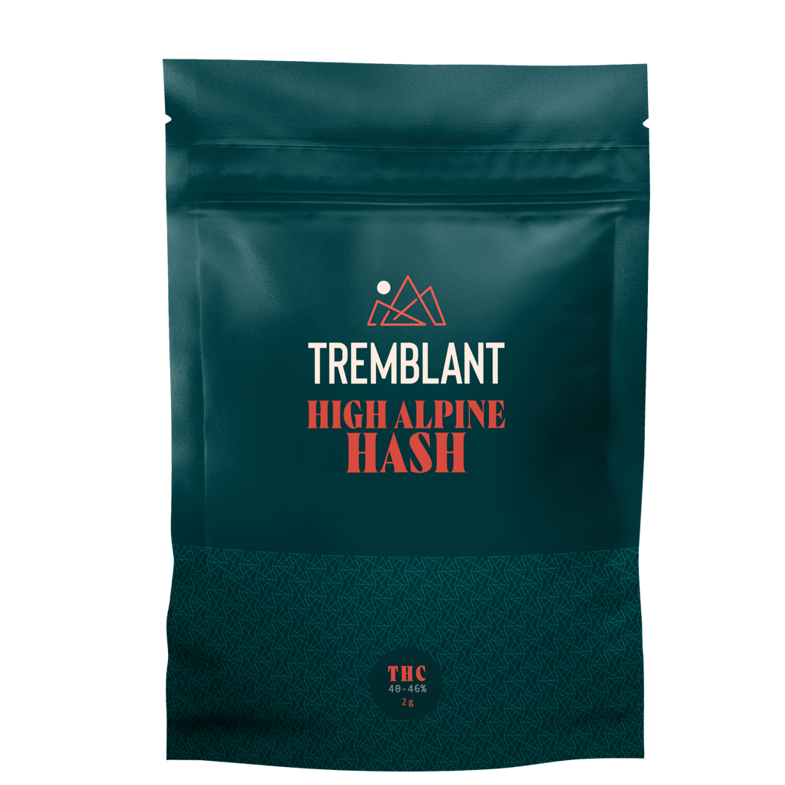
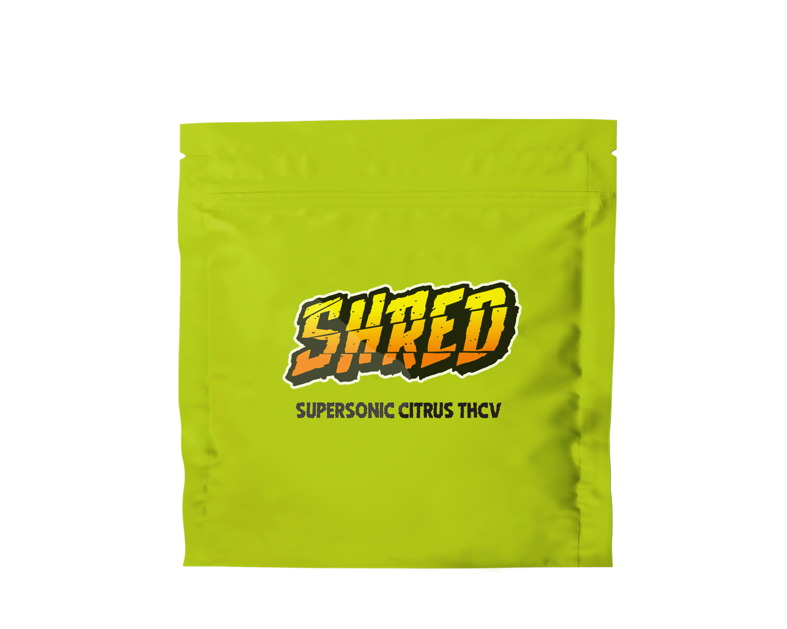
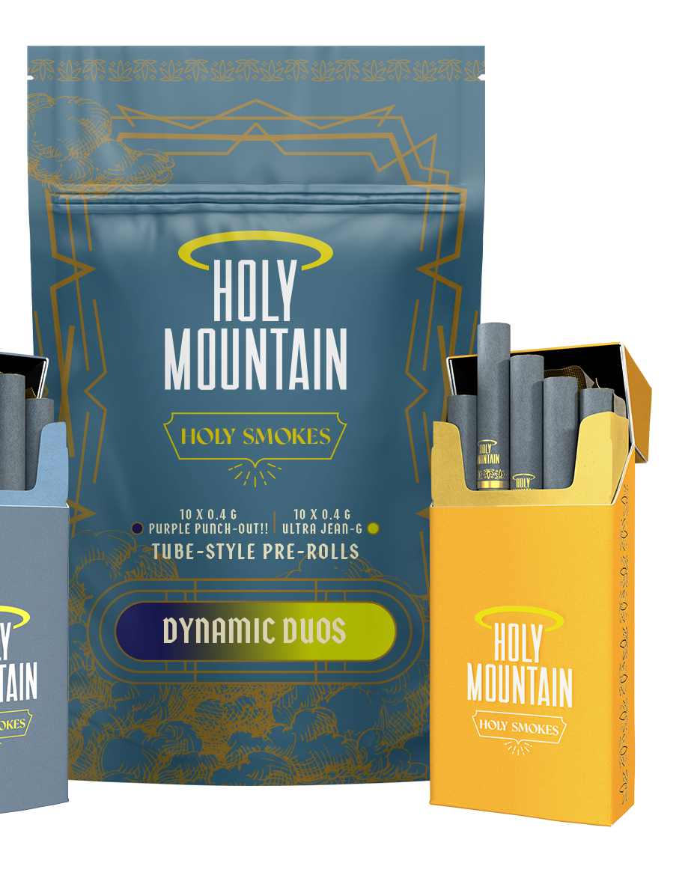
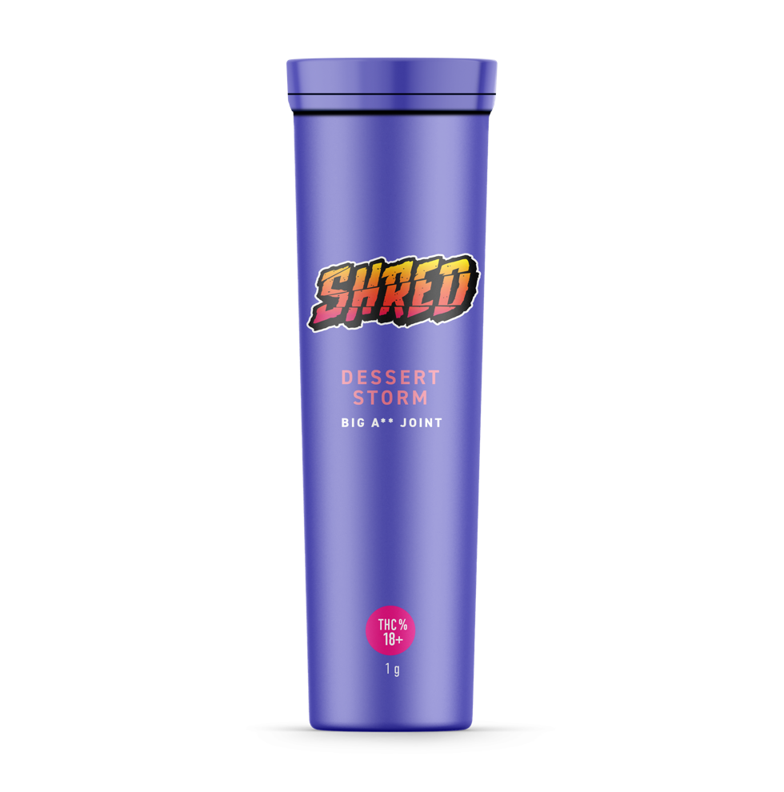
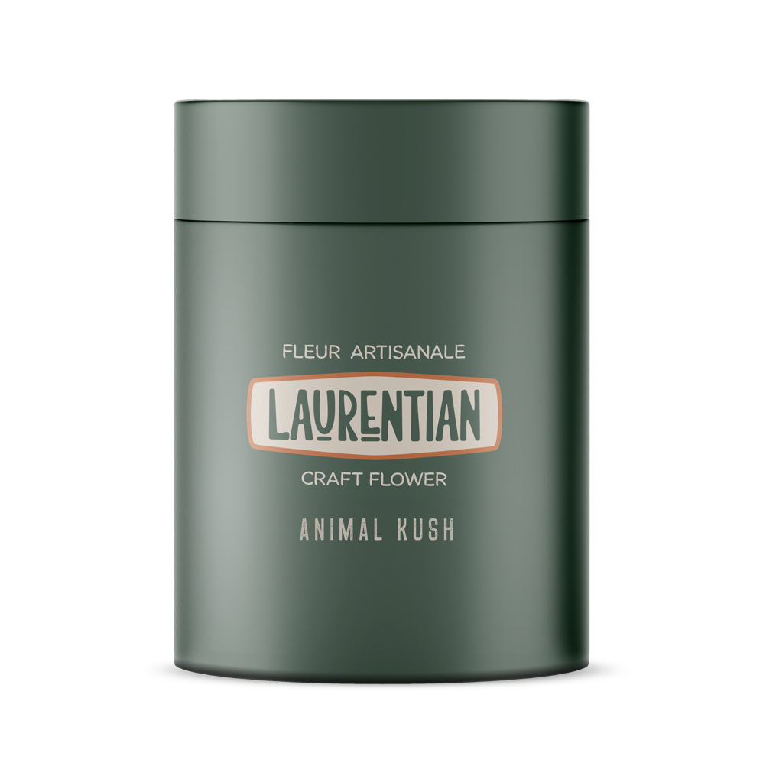
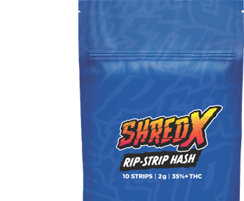





A leading Canadian lp
Organigram held the #3 national market share position¹
Held the #1 position in milled flower, the #1 position in hash, the #2 position in gummies, the #2 position in infused pre-rolls, and the #3 position in pre-rolls nationally¹
Organigram is a top 3 LP in Canada in every major product category, apart from vapes¹
#1 in LP in Atlantic Canada, #3 in Ontario, and held top 5 market position in rest of Canada¹
1. As of March 31, 2024 – Multiple Sources (Hifyre, Weedcrawler, provincial boards, internal modelling).
26

Slide 27



Q2 F2024 highlights
21% growth in recreational net revenue
First Jupiter private placement tranche closed adding $41.5 million of cash bringing Organigram's closing cash balance at quarter-end to $83.6 million
Subsequent to quarter end, closed $28.8 million oversubscribed marketed offering, which when combined with remaining two Jupiter tranches will increase cash position by additional $110 million
Company's recent investment in OBX adds to growing U.S. portfolio, which includes Phylos
Held the #1 position in milled flower, #1 in hash, #1 in ingestible extracts, #1 in pure CBD gummies, #2 in edibles, #2 in infused pre-rolls, #3 in pre-rolls, #3 in dried flower, and held the overall #3 market position in Canada¹
#1 market share position in Atlantic Canada, #3 in Ontario, and a top 5 LP in every Canadian province¹
The Company's SHRED brand surpassed $200 million in annual retail sales as a result of brand loyalty, product quality, and consistent innovation¹
Completed first international flower shipment to Sanity Group in Germany and first flower shipment to 4C Labs for UK distribution
Subsequent to quarter end, signed two new international supply agreements in Australia and in the UK
Successfully completed preliminary EU-GMP audit of Moncton facility
Preliminary pharmacokinetic study results for nano-emulsion ingestible products indicate substantiated rapid onset, predictable duration, and greater bioavailability of cannabinoids
Closed strategic investment in OBX of US $2 million structured as a convertible note
Completed first harvest of seed-based production and planted additional seed-based grow rooms resulting from technology acquired from the strategic investment in US-based Phylos
Company has achieved over $3.7 million in domestic THCV retail sales since launch in August 2023¹ and subsequent to Q2 Fiscal 2024 shipped first international THCV flower, further leveraging Organigram's strategic investment in Phylos
1. As of March 31, 2024 – Multiple Sources (Hifyre, Weedcrawler, provincial boards, internal modelling).

Slide 28

Q2 F2024 efficiency milestones
Harvest of 19.9 kg of flower in Q2 Fiscal 2024
Increasing efficiency through internalizing testing, remediation, as well as increasing automation
  Identified $10 million in targeted savings for Fiscal 2024
  $2.4 million in savings realized in Q2 Fiscal 2024 and $4.7 million realized FYTD
79% increase in flower produced with over 24% THC content
25% of all harvest now between 24-26% THC
25% of all harvest now over 26% THC
Implemented additional automation with a check weigher in both hash and pre-rolls production to reduce labour
Increased output of pectin gummies from 170,000 gummies per day to up to 300,000 gummies per day by optimizing the formulation and extending workings shifts. Organigram produced 4.2 million gummies in March 2024
Initiated program to achieve 18% in cannabinoids saving through in line active dosing tanks in the gummy manufacturing line
Optimized and consolidated underutilized warehouses in Moncton and Winnipeg resulting in $0.3 million in savings
Shortened THC-to-CBN conversion time from 180 to 40 hours. CBN isolate production commenced with capacity of 20kg per month
Implemented in-house lab testing in Winnipeg to minimize waste on the gummy manufacturing line
Second ultrasonic knife at Lac-Supérieur facility increased Rip-Strip production while reducing labour costs by 33% of packaging staff
EFFICIENCY

Slide 29
Quarterly revenue
Q4 F23 represents a 4-month period due to a change in Organigram's year end. Net and gross revenue here have been normalized to reflect a 3-month period.
REVENUE
$ millions
¹

Slide 30
Adjusted gross margin
ADJUSTED GROSS MARGIN¹
$ millions and % of Net Revenue
Adjusted gross margin is a non-IFRS financial measure not defined under IFRS and which does not have any standardized meaning under IFRS and might not be comparable to similar financial measures disclosed by other issuers; please refer to the cautionary statement at the beginning of this document and the Company's Q2 Fiscal 2024 MD&A for definitions and a reconciliation to IFRS
2

Slide 31
Adjusted EBITDA
2. Q4 F2023 represents 4 months due to a change in Organigram's year end. Adjusted EBITDA here has been normalized to reflect a 3-month period.
ADJUSTED EBITDA¹
$ millions
Adjusted EBITDA is a non-IFRS Financial Measure not defined by and does not have any standardized meaning under IFRS and might not be comparable to similar financial measures disclosed by other issuers; please refer to the cautionary statement at the beginning of this document and the Company’s Q2 Fiscal 2024 MD&A for definitions and a reconciliation to IFRS.
2

Slide 32






STRONG BALANCE SHEET AND LIQUIDITY
On March 31, 2023, the Company had cash of $83.6 million ​(including restricted cash)
In January 2024, the Company closed the first $41.5 million tranche of $124.6 million follow-on investment from BAT
In April 2024, the Company closed a financing for gross proceeds of $28.8 million
Pro-forma cash position of ~$195 million upon the anticipated closure of the final BAT tranche
Negligible debt (less than $0.2 million)

Slide 33
Q2 Fiscal 2024 key financial metrics
 | Q2'24 | Q2'23 | % Change
Gross revenue | 57.4 | 52.9 | 9%
Excise taxes | (19.8) | (13.4) | 48%
Net revenue | 37.6 | 39.5 | (5%)
Cost of sales | 26.4 | 29.6 | (11%)
Gross margin before fair value changes to biological assets & inventories sold | 11.2 | 9.9 | 14%
Realized fair value on inventories sold and other inventory charges | (11.1) | (14.2) | 22%
Unrealized gain on changes in fair value of biological assets | 9.4 | 14.1 | (33%)
Gross margin | 9.6 | 9.8 | (2%)
Adjusted gross margin¹ | 11.6 | 13.4 | (13%)
Adjusted gross margin %¹ | 31% | 34% | (3%)
Selling (including marketing), general & administrative expenses | 20.2 | 16.1 | 25%
Adjusted EBITDA¹ | (1.0) | 5.6 | nm
Net income (loss) | (27.1) | (7.5) | 262%
Net cash provided by (used in) operating activities | (13.2) | (19.7) | (33%)
In $ millions unless otherwise indicated
Adjusted gross margin, adjusted gross margin % and adjusted EBITDA are non-IFRS financial measures not defined by and do not have any standardized meaning under IFRS and might not be comparable to similar financial measures disclosed by other issuers; please refer to the cautionary statement at the beginning of this document and the Company’s Q2 Fiscal 2024 MD&A for definitions and a reconciliation to IFRS.

Slide 34
appendix

Slide 35


March 2021 BAT Transaction Summary
Investment | Subsidiary of BAT subscribed for 58.3M common shares of Organigram, which represented a 19.9% equity interest in March 2021¹ on a post-transaction basis Total proceeds to Organigram in March 2021 of ~C$221 million (the “Investment Proceeds”) The price per share in March 2021 was based on a five-day volume weighted average price on the TSX ended March 9, 2021 In March 2022 received $6.3M investment from BAT through the exercise of certain top-up rights pursuant to an Investor Rights Agreement, bringing BAT’s equity ownership to 19.4%
Product Development Collaboration (“PDC”) | ~$30M of Investment Proceeds reserved to satisfy certain of Organigram’s obligations under the PDC agreement, including Organigram’s portion of its funding obligations under a mutually agreed budget for the Center of Excellence Remaining net Investment Proceeds may be used by Organigram for general corporate purposes, subject to certain proceed restrictions Costs relating to the Center of Excellence will be funded equally by OGI and BAT Organigram and BAT to focus on development of cannabis vapour products, cannabis oral products and any other products, IP and technologies mutually agreed upon Both Organigram and BAT to have access to certain of each other’s intellectual property (“IP”) and, subject to certain limitations, have the right to independently globally commercialize the products, technologies and IP
Governance and Deal Protections | Board Representation: BAT entitled to appoint (i) 20% of the Board of Directors of Organigram (the “Board”) for so long as BAT holds at least 15% of the issued and outstanding common shares of Organigram from time to time and (ii) 10% of the Board so long as BAT holds at least 10% of the issued and outstanding common shares of Organigram from time to time BAT nominees, Mr. Simon Ashton was added to the Board in February 2022 and Ms. Ferland was added to the Board in March 2023 but subsequently resigned in September 2023 Investor Rights BAT has a right to participate in equity issuances to maintain its percentage shareholding, subject to customary exceptions, and periodic top-up rights to permit maintenance of its percentage ownership following exempt issuances BAT has customary pro rata piggy-back registration rights, and is subject to certain share transfer restrictions
Calculated on a non-diluted basis.

Slide 36
November 2023 BAT Transaction Summary
Investment | Subject to requisite Organigram shareholder approval, regulatory approvals and other conditions, subsidiary of BAT to subscribe for, in aggregate, ~38.7 million shares of Organigram, over three tranches, at C$3.2203/share. Total gross proceeds to Organigram of C$124.6 million Subsidiary of BAT, subject to Organigram shareholder approval, regulatory approvals and other conditions, will subscribe for: Tranche 1 - ~12.9 million shares on or around January 16, 2024, for C$41.5 million Tranche 2 - ~12.9 million shares on or around August 30, 2024, for C$41.5 million Tranche 3 - ~12.9 million shares on or around February 28,2025, for C$41.5 million
Capital Allocation and “Jupiter” Investment Pool | Organigram to create a Strategic Investment Pool named Jupiter (“Jupiter”), to be funded with C$83.1 million over the course of the three tranches of the investment Remaining net Investment Proceeds of C$41.5 million may be used by Organigram for general corporate purposes Jupiter will target investments in emerging cannabis opportunities that enable Organigram to apply industry-leading capabilities to new markets, thus expanding its global footprint Jupiter to be set-up and managed by an internal team at Organigram
Governance and Deal Protections | Board Representation: Under the Amended and Restated IRA, BAT would be eligible to appoint up to 30% of the Board. Investor Rights: BAT has a right to participate in equity issuances to maintain its percentage shareholding, subject to customary exceptions, and periodic top-up rights to permit maintenance of its percentage ownership following exempt issuances. BAT has customary pro rata piggy-back registration rights and is subject to certain share transfer restrictions. BAT has certain minority protections, including approval rights over certain fundamental transactions.

Slide 37

An uplifting & vibrant value brand
focused on convenience.
Tropic Thunder 7g pre-milled Wild Berry Blaze SHRED’ems Gnarberry 1g 510 vape
SHRED X Rip Strips
37

Slide 38


An imaginative brand
with iconic strains and stellar extracts.
Holy Mountain
Mac-1 3.5 g, R*ntz 3.5g, Pressed Hash
38

Slide 39


Delivering high-quality ounces
in a variety of strains.
Pink Cookies I.C.C.
Ultra Sour
39

Slide 40


CBD and minor cannabinoid gummies, designed for a personal wellness ritual.
Monjour Berry Good Day Monjour Orchard Medley
40

Slide 41


A premium brand focused on
flower & innovation.
Limelight 3.5g dried flower Edison JOLTS – Electric Lemon
Cherry Limelight Bubble Hash Joints
41

Slide 42


Premium hash, inspired by
the timeless tradition of hashish.
Tremblant 2g Hash
42

Slide 43


Craft cannabis featuring rare cultivars grown with utmost attention and care.
Laurentian Saisons
3.5 g
43

Slide 44







Craft cannabis featuring rare cultivars grown with utmost attention and care.
Laurentian Saisons
3.5 g
44

Slide 45
Q2 fiscal 2024 select balance sheet metrics
Select Balance sheet metrics | March 31, 2024 | September 30, 2023 | % Change
Cash & short-term investments (excluding restricted cash) | 72,606 | 33,864 | 114%
Biological assets & inventories | 83,264 | 80,953​ | 3%​
Restricted Cash | 11,028 | 17,893 | (38%)
Other current assets | 38,392 | 41,159 | (7%)​
Accounts payable & accrued liabilities | 40,174 | 20,007​ | 101%
Current portion of long-term debt | 66​ | 76​ | (13%)
Working capital | 138,228 | 133,545 | 4%
Property, plant & equipment | 97,122 | 99,046 | (2%)
Long-term debt | 52​ | 79​ | (34%)
Total assets | 331,778 | 298,455 | 11%
Total liabilities | 59,981 | 26,832 | 124%
Shareholders’ equity | 271,795 | 271,623 | nm
In $000s unless otherwise indicated

Slide 46
Q2 FISCAL 2024 CAPITAL STRUCTURE
in $000s | March 31, 2024 |  | Sept 30, 2023
Current and long-term debt | 118 |  | 155
Shareholders’ equity | 271,797 |  | 271,623
Total debt and shareholders’ equity | 271,915 |  | 271,778
in 000s
Outstanding common shares | 94,469 |  | 81,162
Options | 2,840 |  | 2,830
Warrants | - |  | 4,236
Top-up rights | 1,943 |  | 2,035
Restricted share units | 3,825 |  | 881
Performance share units | 1,170 |  | 261
Total fully-diluted shares | 104,247 |  | 91,405

Slide 47

A CANADIAN
CANNABIS LEADER
NASDAQ (OGI)
TSX (OGI)

